Slide 1
A Snapshot of the Hungarian Loan Market
EMEA Loan House
Best Arranger of Western European Loans

Slide 2
Agenda
BNP Paribas: A Driving Force in the EMEA Loan Market
Hungarian vs. CEE Syndicated Loan Markets
Hungarian Banking System
Risks to Hungarian Bank Liquidity Going Forward

Slide 3
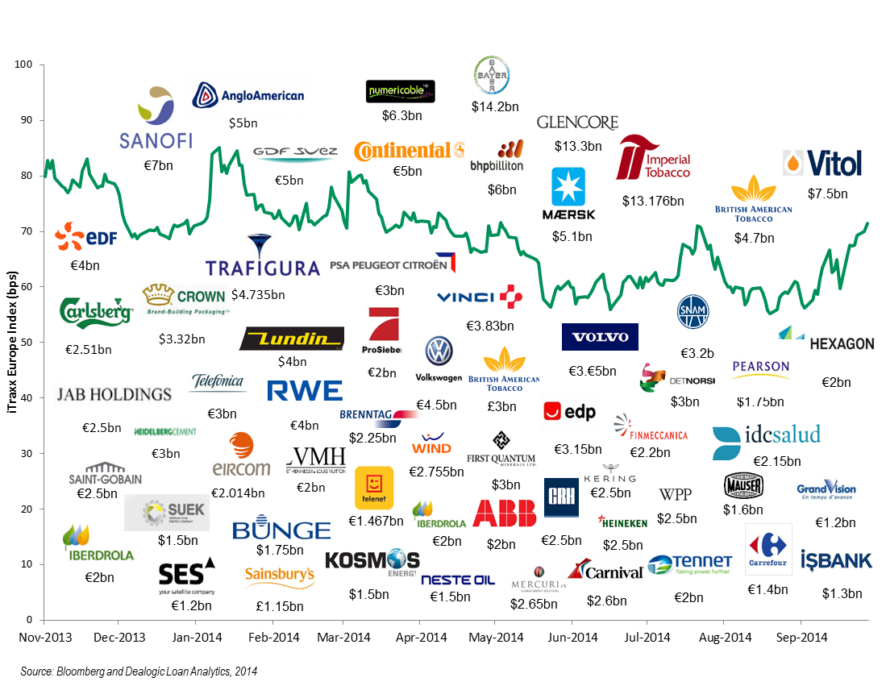
BNP Paribas is the Leading House in the EMEA Loan Market
Continuing to Arrange Key Deals Throughout The Cycle
EMEA – Bookrunner 9M 2014 (by volume)
 | Bookrunner | US$ m | No. deals | % share
1 | BNP Paribas | 43,822.43 | 178 | 7.85
2 | Credit Agricole | 28,908.16 | 119 | 5.18
3 | Barclays | 27,675.38 | 104 | 4.95
4 | HSBC | 26,965.30 | 155 | 4.83
5 | UniCredit | 25,320.61 | 122 | 4.53
6 | RBS | 24,957.38 | 97 | 4.47
7 | Commerzbank | 24,717.22 | 143 | 4.43
8 | Citi | 24,555.89 | 90 | 4.40
9 | Deutsche | 23,293.98 | 114 | 4.17
10 | ING | 22,504.92 | 111 | 4.03
Best Arranger of French Loans
Deal of the Year - Virgin Media
Best Arranger of Western European loans
EMEA Loan House 2013

Slide 4
Hungarian vs. CEE Syndicated Loan Markets
Syndicated Loan Volumes
Hungarian syndicated loan volumes since 2009:
Remained suppressed
Low proportion of the CEE volumes (7-10%)
Volume uplift in 2014 combined with an increase in the percentage of Hungarian volumes within the CEE (18%):
Mainly due to the EUR 1.32bn loan facility secured by Budapest Airport
Hungarian volumes as % of CEE volumes | 19% | 18% | 24% | 17% | 8% | 10% | 7% | 7% | 18%
Source: Dealogic Loan Analytics, 2014
Breakdown by Sector - 2013 & YTD 2014
Utility & Energy and Oil & Gas are dominant sectors in both the CEE and the Hungarian syndicated loan markets
CEE
Hungary
Source: Dealogic Loan Analytics, 2014
4

Slide 5
Hungarian vs. CEE Syndicated Loan Markets
Breakdown by Purpose - 2013 & YTD 2014
CEE and Hungarian loan markets were both dominated by refinancings in 2013 & YTD 2014
However, less Hungarian borrowers accessed the syndicated loan market for Event Driven transactions
CEE
Hungary
Source: Dealogic Loan Analytics, 2014
Breakdown by Tenor & Currency - 2013 & YTD 2014
Key features of the Hungarian Syndicated Loan Market
Hungary
Hungary
3-5 years is the most common tenor for Corporates. However, banks prefer shorter tenors for smaller borrowers
Hungarian borrowers are to a larger extent borrowing in USD due to a higher proportion of oil & gas transactions
The Hungarian syndicated loan market is dominated by international banks
CEE
CEE
Source: Dealogic Loan Analytics, 2014
5

Slide 6
Hungarian Loan Book Composition
Total Loan Book Composition
As of 31 March 2014, corporate and retail lending accounted for 46% and 48% of banks’ total loans, respectively
The remaining 6% are loans provided to public-sector entities
Source: National Bank of Hungary, as of Q1 2014
Composition of Corporate Loan Portfolio
Banks have relatively large industry concentration, with significant exposures to real-estate & construction, as well as manufacturing and trade sectors
Combined, these three industries accounted for 67% of corporate loans
Source: National Bank of Hungary, as of Q1 2014

Slide 7
Hungarian Banking Landscape
Hungary’s Banking Sector Assets
8 Largest Banks by Assets | % of Total Banks Assets | Rating S&P / Moody’s / Fitch
OTP Bank Nyrt | 29% | BB / Ba2 / NR
K&H | 10% | NR / Ba3 / BBB-
Erste Bank Hungary | 9% | NR / B3 / BBB-
MKB Bank | 7% | NR / Caa2 / NR
CIB Bank | 7% | NR / BBB- / NR
Raffeisen Bank | 7% | A- / A3 / A
UniCredit Bank | 7% | BBB / Baa2 / BBB+
FHB Bank | 4% | NR / B3 / NR
Source: MNB
The 8 largest banks own c. 80% of total bank assets
Key Lenders depending on Categories
Large-Caps
Mid-Caps
SMEs

Slide 8
Hungarian Loan Market: Key take-aways from discussions with local banks
Secured market globally - except for some larger borrowers that benefit from the ability to do unsecured borrowings
Ticket Size from Local Banks?
Secured / Unsecured Market?
Tenors Available?
Liquidity Available for Hungarian Borrowers?
Government Funding Program Effect on Pricing?
Premium for Funding in EUR?
EUR 5-10 million for SMEs
EUR 10-20 million for mid-caps
More for the largest borrowers
Tenor of less than 5 years is the norm
Longer tenor is possible but comes at a price
Bank have a preference for 1-3 year tenor for SMEs
EUR 10 million for SMEs
EUR 100 million for mid- caps
More for the largest borrowers
Based on BNP Paribas’ discussions with 9 local banks
Most local banks will price with a premium for funding in EUR
Have had limited impact on pricing for SMEs – but helped increase liquidity
Have created some price pressure on pricing for mid-caps

Slide 9
Risk factors that are likely to affect Hungarian bank liquidity going forward
Asset quality expected to continue to deteriorate
Non-performing loans are expected to reach 24% of total loans by 2015
Mainly driven by increase in non-performing loans and the moratorium on residential evictions for borrowers
Consequently, this puts further pressure on banks’ capital ratios
High bank taxes/levies and FX mortgage conversions to forints are also likely to hit the banking sector’s revenues & profitability going forward
Compensation charges to retail borrowers is expected to reach HUF 1trn, or 28% of banking system’s total capital
These actions are likely to impact banks’ capital ratios, liquidity, growth ambitions and as a result, constrain lending to SMEs and mid-caps in the next years to come
Certain foreign parent banks re-assess their strategies in the country
Some have reduced the volume of FX loans that they extend to their Hungarian subsidiaries, partially substituting them with newly established FX swaps
However, most foreign parent banks have confirmed that they intend to stay in Hungary
Government measures
Foreign banks
9

Slide 10
Risk factors that are likely to affect Hungarian bank liquidity going forward
Overcrowding of the Hungarian banking sector
Domestic banks own approx. 50% of Hungarian banking assets today
Government’s target of 60-70% domestic ownership - still a bit to go...
Consolidation of the banking sector is expected
The Scheme seems to have helped increase domestic demand, but as debt financed, it is a question for how long the program can go on without putting pressure on the 3% budget deficit limit set under the EU’s Maastricht criteria.
Funding for Growth Scheme
Conclusions
While economical growth has returned to Hungary, the outlook for the banking sector remains mixed.
It is likely there will be less Tier 1 capital available from banks as both International and Domestic banks will have to absorb losses and operate in a less favourable economic environment. This could potentially lead to less liquidity available in the mid-cap and SME sector.
However, the largest corporates which benefit from support also from international banks might be in a stronger position and continue to attract a healthy level of bank liquidity.
10

Slide 11
Disclaimer
The material in this presentation was produced by a BNP Paribas Group Company for information purposes only.
The information and opinions contained in this presentation have been obtained from public sources believed to be reliable, but no representation, warranty or undertaking, express or implied, is made or given whether such information is accurate, reasonable, authentic, valid or complete and it should not be relied upon as such. This presentation is not, and should not be construed as, an offer document or an offer or solicitation to buy or sell any investments nor shall it form the basis of or be relied upon in connection with any contract or commitment whatsoever or be taken as investment advice. Any products mentioned herein may not be registered for public sale in a particular jurisdiction and their availability for investment or distribution is restricted and subject to local applicable laws and regulations, including sale only to professional or institutional investors. No BNP Paribas Group Company accepts any liability or responsibility whatsoever for any direct or consequential loss arising from any use of material contained in this presentation. This presentation is confidential and is submitted to selected recipients only. It may not be reproduced (in whole or in part) to any other person. A BNP Paribas Group Company and/or persons connected with it may effect or have effected a transaction for their own account in any investments referred to in the material contained in this presentation or any related investment before the material is published to any BNP Paribas Group Company’s customers. On the date of this presentation a BNP Paribas Group Company, persons connected with it and their respective directors and/or representatives and/or employees may have a long or short position in any of the investments mentioned in this report and may purchase and/or sell the investments at any time in the open market or otherwise, in each case either as principal or as agent. Additionally, a BNP Paribas Group Company within the previous twelve months may have acted as an investment banker or may have provided significant advice or investment services to the companies or in relation to the investment(s) mentioned in this presentation.
This presentation is prepared for professional clients and eligible counterparties and is not intended for retail clients as defined in the Markets in Financial Instruments Directive, and should not be passed on to any such persons.
France
This presentation has been approved for publication by BNP Paribas, a credit institution which is authorised by the Autorité de Contrôle Prudentiel et de Résolution (ACPR) and regulated by the Autorité des Marchés Financiers in France, and whose head office is 16, Boulevard des Italiens 75009 Paris, France.
United Kingdom
This presentation has been approved for publication by BNP Paribas London Branch, a branch of BNP Paribas, 10 Harewood Avenue, London NW1 6AA. This branch is authorised by the Autorité de Contrôle Prudentiel and the Prudential Regulation Authority and subject to limited regulation by the Financial Conduct Authority and Prudential Regulation Authority and registered in England & Wales under No. FC13447. Details of the extent of the authorisation and regulation by the Prudential Regulation Authority, and regulation by the Financial Conduct Authority are available on request.
Italy
This publication has been approved for publication and distribution by BNP Paribas Succursale Italia which has been authorised by the Autorité de Contrôle Prudentiel and regulated by the Autorité des Marchés Financiers, and this authorisation has been notified to the Bank of Italy. The branch is subject to limited regulation by the Bank of Italy and the CONSOB respectively.
US
This document is being distributed to U.S. persons by BNP Paribas Securities Corp., or by a subsidiary or affiliate of BNP Paribas that is not registered as a U.S. broker-dealer to U.S. major institutional investors only. Any U.S. person receiving this document and wishing to effect a transaction in any security discussed herein, must do so through a U.S. registered broker dealer. BNP Paribas Securities Corp., a subsidiary of BNP Paribas, is a broker-dealer registered with the U.S. Securities and Exchange Commission and a member of the Financial Industry Regulatory Authority and other principal exchanges. BNP Paribas Securities Corp. accepts responsibility for the content of a report prepared by another non-U.S. affiliate only when distributed to U.S. persons by BNP Paribas Securities Corp. Some of the securities mentioned in this document have not been registered under the United States Securities Act of 1933, as amended, and may not be offered or sold in the United States or to a U.S. person absent registration or an applicable exemption from the United States registration requirements.
Spain
This document is being distributed in Spain by BNP Paribas S.A., S.E., a branch of BNP Paribas S.A. whose head office is in Paris, France. BNP Paribas S.A.,, S.E., C/Ribera de Loira 28, Madrid 28042 is authorised and supervised by the Autorité de Contrôle Prudentiel and it is authorised and subject to limited regulation by the Bank of Spain.
Switzerland
This document is intended solely for customers who are “Qualified Investors” as defined in article 10 paragraphs 3 and 4 of the Swiss Federal Act on Collective Investment Schemes of 23 June 2006 (CISA) and the relevant provisions of the Swiss Federal Ordinance on Collective Investment Schemes of 22 November 2006 (CISO). “Qualified Investors” includes, among others, regulated financial intermediaries such as banks, securities dealers, fund management companies and asset managers of collective investment schemes, regulated insurance companies as well as pension funds and companies with professional treasury operations. This document may not be suitable for customers who are not Qualified Investors and should only be used and passed on to Qualified Investors. For specification purposes, a “Swiss Corporate Customer” is a Client which is a corporate entity, incorporated and existing under the laws of Switzerland and which qualifies as “Qualified Investor” as defined above."
BNP Paribas (Suisse) SA is authorised as bank and as securities dealer by the Swiss Federal Market Supervisory Authority FINMA. BNP Paribas (Suisse) SA is registered at the Geneva commercial register under No. CH-270-3000542-1. BNP Paribas (Suisse) SA is incorporated in Switzerland with limited liability. Registered Office: 2 place de Hollande, CH-1204 Geneva.
Bahrain
This document is being distributed in Bahrain by BNP Paribas Wholesale Bank, a branch of BNP Paribas S.A. whose head office is in Paris, France. BNP Paribas Wholesale Bank is regulated as a Registered Institution by the Central Bank of Bahrain – CBB.
This document does not, nor is it intended to, constitute an offer to issue, sell or acquire, or solicit an offer to sell or acquire any securities or to enter into any transaction.
By accepting this document you agree to be bound by the foregoing limitations.
BNP Paribas (2014). All rights reserved.

